Slide 1
Push notification using web services

Slide 2
AGENDA
Callback between C# and C/C++
Asmx web service
WCF web services
Websocket
Microsoft SignalR
Q&A

Slide 3
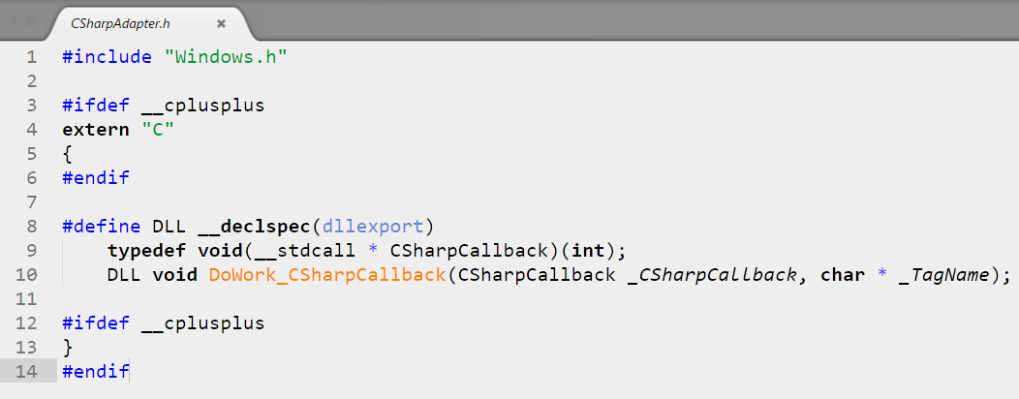
callback implementation 1 in C/C++

Slide 4
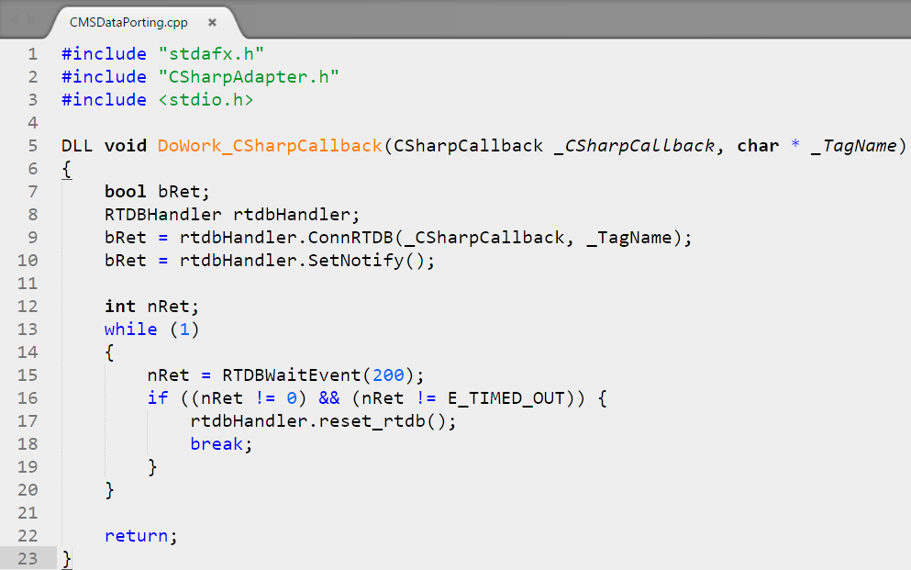
callback implementation 2 in C/C++

Slide 5
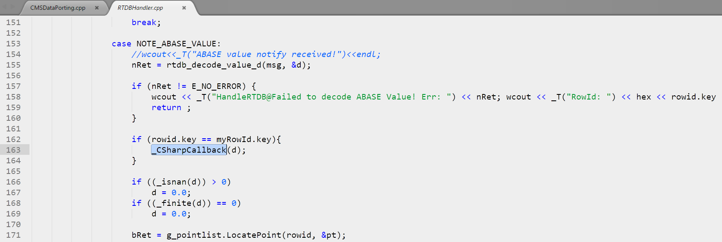
callback implementation 3 in C/C++

Slide 6
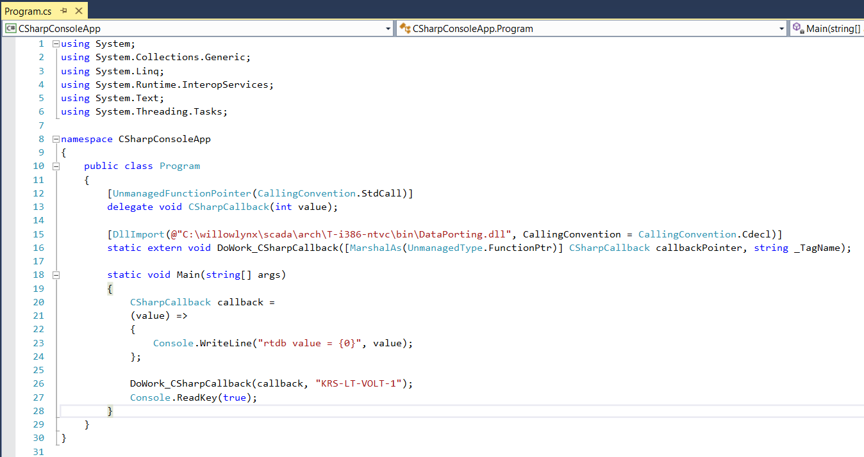
callback implementation 4 in C#

Slide 7
Asmx web service
(Advantage) As it is web service, the consumer can be in any platform. (eg. Window, OS X, Linux)
(Disadvantage) Only SOAP can be supported (Very difficult to implement to support RESTful)
(Disadvantage) Duplex communication are not supported, it means whenever client need the value from server, client must send the request.
(Disadvantage)So it cannot behave as a broadcasting station.
(Disadvantage)So it do not support callback functionalities.

Slide 8
WCF Web Service
(webHttpBinding) To create restfull service
(basicHttpBinding) Soap version 1, same as Asmx
(wsHttpBinding) Soap version 2, more secure
(wsDualHttpBinding) To creare callback service, also known as wcf duplex service.

Slide 9
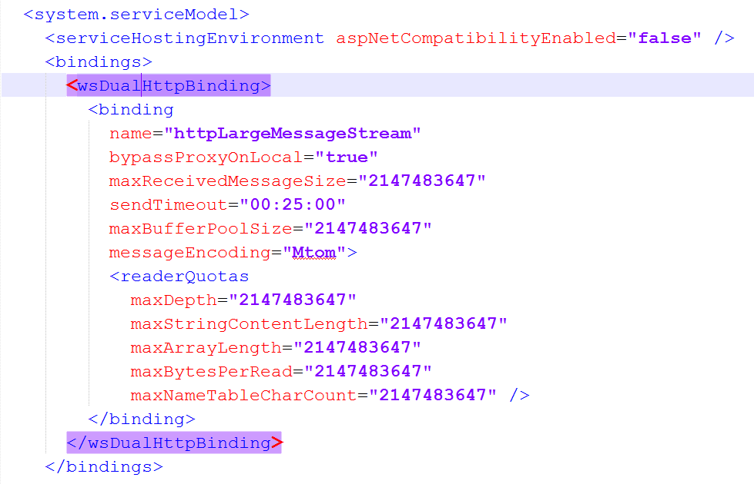
WCF duplex Service Config

Slide 10
Wcf Callback Implementation Between Client & Server
Let’s see the sample Code

Slide 11
Disadvantage of WCF Duplex Service
It only support SOAP protocol. If client cannot use SOAP, that client cannot consume the service.
But there is another alternative technology known as Websocket.

Slide 12
WebSocket
It support full duplex communication between server and client.
It can broadcast to every clients
So, how to use the websocket, there is a API called SignalR developed by Microsoft.

Slide 13
Microsoft SignalR
SignalR created on top of WebSocket technology. Whatever websocket can do, SignalR can also do.
Allow full duplex communication between client and server
No more binding is requred which we needed in WCF.
No need complex configuration like we needed in WCF.
It can integrated with RESTful service

Slide 14
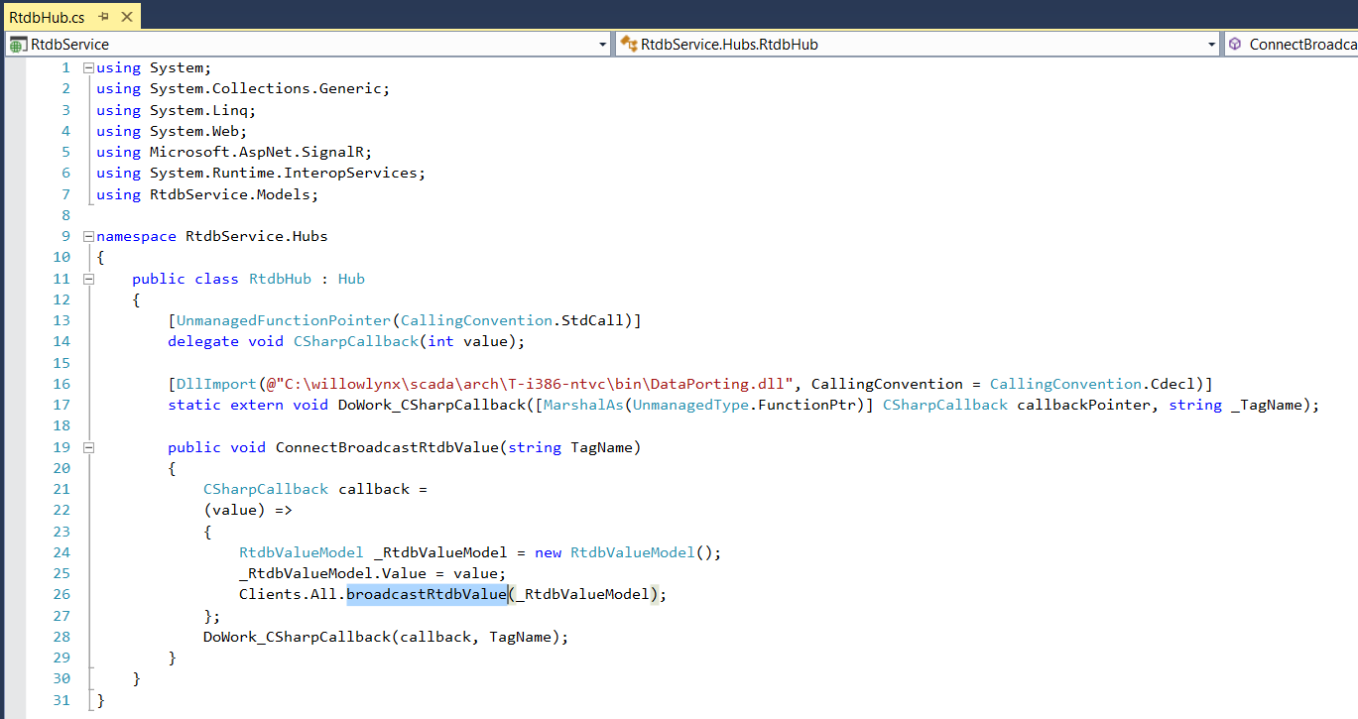
Service provider

Slide 15
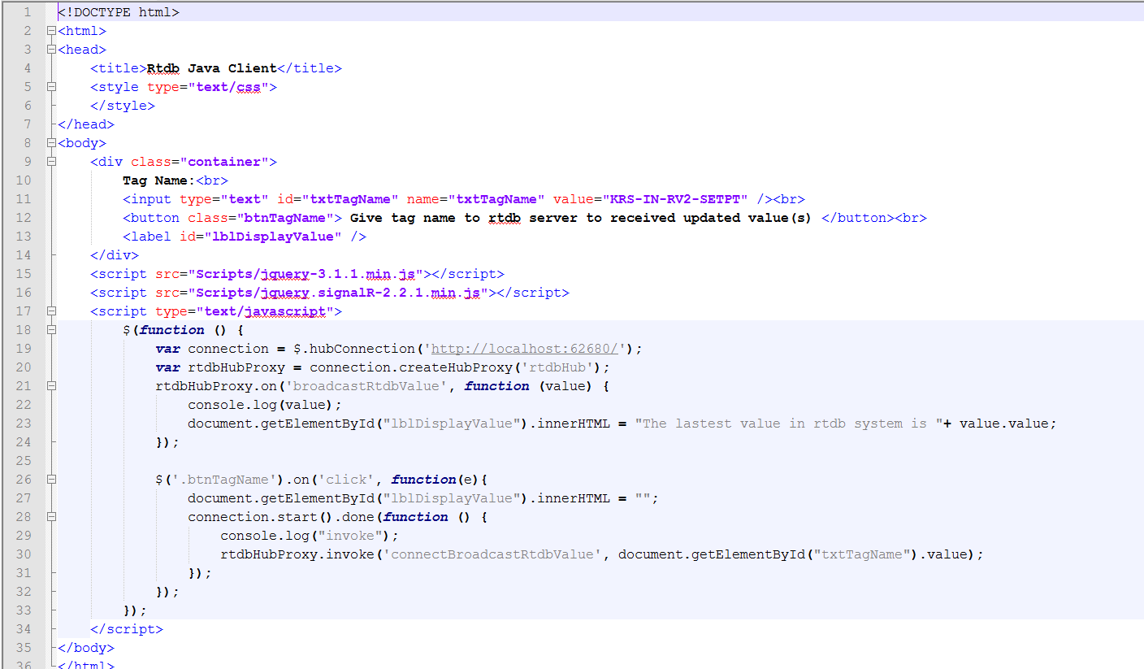
Service Consumer

Slide 16
Sample Source Codes

Slide 17
ANY QUESTIONS?

Slide 18
THANK YOU

